Slide 1
Testing Zephyr’s Clock Management Subsystem
Dylan Arturo Velasco Pinilla

Slide 2
Testing Strategy
Two complementary test configurations:
Test procedure: Establish a known default configuration → perform one clock defined operation → check the API result and affected output rates → restore the setup for the next test.
Static tests validate predefined configurations; dynamic tests validate how the subsystem coordinates changes at runtime.
Static | Dinamic
Runtime features disabled | RUNTIME and SET_RATE enabled
Apply devicetree-defined clock states | Change requests from multiple consumers
Verify transitions and resulting output frequencies | Verify state voting, conflicts, and rank-based selection
Check that each configured path produces the expected rate | Verify locking and requested-rate selection

Slide 3
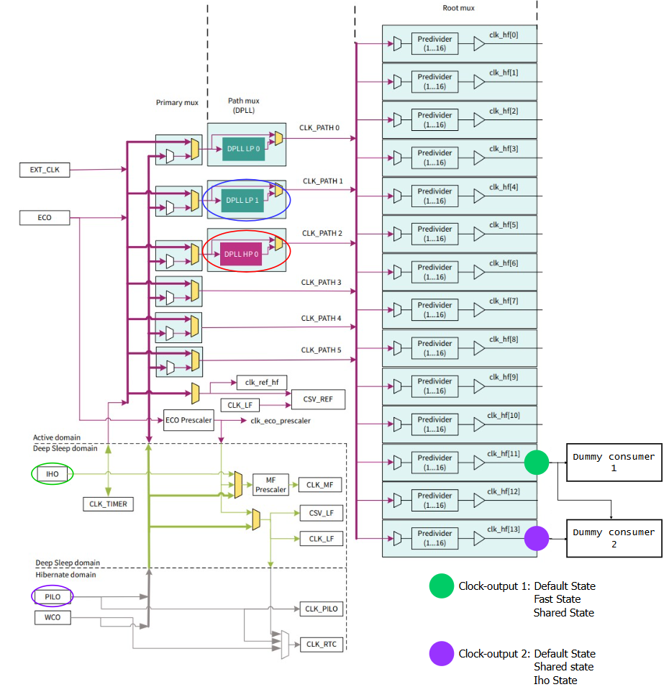
Clock Tree Under Test
Two consumers share HF11.
One also uses HF13.
Both outputs can depend on common upstream producers.
This topology lets us test direct request conflicts and the effects of rate changes across separate outputs

Slide 4
Clock Output States Under Test
Devicetree-defined paths and expected output frequencies
Clock-Output | STATE | CLOCK – PATH | OUTPUT FREQ
HF11 | Default | IHO → PLL LP1 → HF11 | 133.33 MHz
HF11 | Fast | IHO → PLL HP → HF11 | 450 MHz
HF11 | Shared | PILO → PATH MUX 3 → HF11 | 16.384 kHz
HF13 | Default | IHO → PLL HP → HF13 | 225 MHz
HF13 | Shared | PILO → PATH MUX 3 → HF13 | 32.768 kHz
HF13 | IHO | IHO → PATH MUX 3 → HF13 | 50 MHz
These six states give us known clock paths and expected frequencies. They let us verify state transitions on each output and exercise dependencies through shared upstream producers.

Slide 5
Consumer Clock Requests
A request lists acceptable states for each output
CONSUMER | REQUEST | HF11 Allowed States | HF13 Allowed States
Dummy 1 | Default | Default | Default
Dummy 1 | Shared | Shared | Shared
Dummy 1 | Fast | Fast | Default
Dummy 1 | IHO | — | IHO
Dummy 1 | All | Default, Shared, Fast | —
Dummy 2 | Default | Default | —
Dummy 2 | Fast | Fast | —
Dummy 2 | Shared | Shared | —
Dummy 2 | Locking | Fast, Shared | —
Compatible requests: Dummy 1 selects All and Dummy 2 selects Fast. Both allow Fast on HF11.
Conflicting requests: Consumer 1 selects Default and Consumer 2 selects Fast. They have no common allowed state for HF11.

Slide 6
Static Clock Configuration Tests
Verify devicetree-defined clock states and output frequencies with runtime management disabled. A setup step requests the default state before each test.
Test | What it verifies
Default state — HF11 | Applies the default state and checks HF11’s expected frequency. Repeats the rate check while turning the output on and off, confirming the reported rate remains consistent in this setup.
Slow state — HF11 and HF13 | Applies the slow request, checks HF11’s slow frequency, and confirms HF13 remains at its default frequency. Rechecks both outputs around on/off operations.
Invalid state | Requests a invalid configuration, a PLL with an input frequency too low to lock, and checks that the request returns an error.
These tests check state application, frequency reporting, on/off operations, and invalid-configuration handling. They do not test runtime voting, reference counting, or notifications.

Slide 7
Runtime State Requests and Shared Producers
Test setup: Before each test, both consumers request their default states. Consumer 1 enables HF11 and HF13; Consumer 2 also enables HF11. This establishes known frequencies and usage counts. Cleanup balances the three enable operations.
Test | Scenario | What it verifies
Default clock rates | Both consumers use their default requests. | HF11 reports its expected default rate through both consumers, while HF13 reports its own default rate. Consumers sharing HF11 observe the same output frequency.
Conflicting state requests | Consumer 1 requires Default on HF11; Consumer 2 requests Fast. | With incompatible requests, HF11 remains at Default rather than switching to Fast. Once both requests agree on Fast, HF11 reports the Fast frequency. Known issue: the incompatible request currently returns success instead of reporting the conflict.
Shared producer | Both consumers move HF11 toward Shared. Consumer 1 then changes HF13 from Shared to IHO; both paths involve Path Mux 3. | HF13 can enter Shared while HF11 remains at Default because Consumer 2 still requires Default. Once Consumer 2 also requests Shared, HF11 changes to Shared. The final request to IHO shows a cross-output effect: changing Path Mux 3 for HF13 gives HF13 50 MHz and changes HF11 to 25 MHz.

Slide 8
Runtime Rate, Gating, and Locking Tests
Test | Scenario | What it verifies
Runtime rate request | Consumer 1 requests 100 MHz on HF13. | The rate-selection path returns 99,999,998 Hz rather than the requested value.
Clock gating and usage counts | Enable HF11 for both consumers and HF13 for Consumer 1. Disable HF11’s clock outputs one at a time, then switch both consumers to Fast and re-enable HF11. | Shared producers’ usage counts decrease as clock outputs are disabled. Changing a state alone does not increase usage counts; enabling the outputs does.
Clock locking | Consumer 1 locks HF11, then switches to a non-locking request. Consumer 2 takes ownership through a locking request, and Consumer 1 attempts another state change. | Only one consumer can own the lock. The non-locking request releases Consumer 1’s lock; Consumer 2’s lock causes Consumer 1’s subsequent request to be rejected.

Slide 9
Runtime Rate, Gating, and Locking Tests
Test | Scenario | What it verifies
Runtime rate request | Consumer 1 requests 100 MHz on HF13. | The rate-selection path returns 99,999,998 Hz rather than the requested value.
Clock gating and usage counts | Enable HF11 for both consumers and HF13 for Consumer 1. Disable HF11’s clock outputs one at a time, then switch both consumers to Fast and re-enable HF11. | Shared producers’ usage counts decrease as clock outputs are disabled. Changing a state alone does not increase usage counts; enabling the outputs does.
Clock locking | Consumer 1 locks HF11, then switches to a non-locking request. Consumer 2 takes ownership through a locking request, and Consumer 1 attempts another state change. | Only one consumer can own the lock. The non-locking request releases Consumer 1’s lock; Consumer 2’s lock causes Consumer 1’s subsequent request to be rejected.

Slide 10
Key Findings from Evaluating Clock Management
1. Recursive validation: state changes require approval from every child → runtime scales with clock tree size; three notification phases (query, pre, post).
2. Sequential producer reconfiguration: a failure mid-path leaves the clock path partially configured at an undesired frequency.
3. Requested vs. achieved frequency: the best configuration is hardware-dependent and can be far from the requested rate.
4. Shared clock paths force consumers to implement callbacks in all three phases to survive rate changes.
5. Bug in request_state(): a losing vote (active requests > vote count) does not return an error as it should.
6. Driver-delegated robustness: Relies on robust drivers; callbacks act as a circuit breaker against harmful reconfigurations.
7. Reliable clock gating: Enables further power management optimization by effectively disabling unused clock paths.
8. Powerful abstraction: Manages and reconfigures complex clock trees by abstracting the configuration process.

